Slide 1
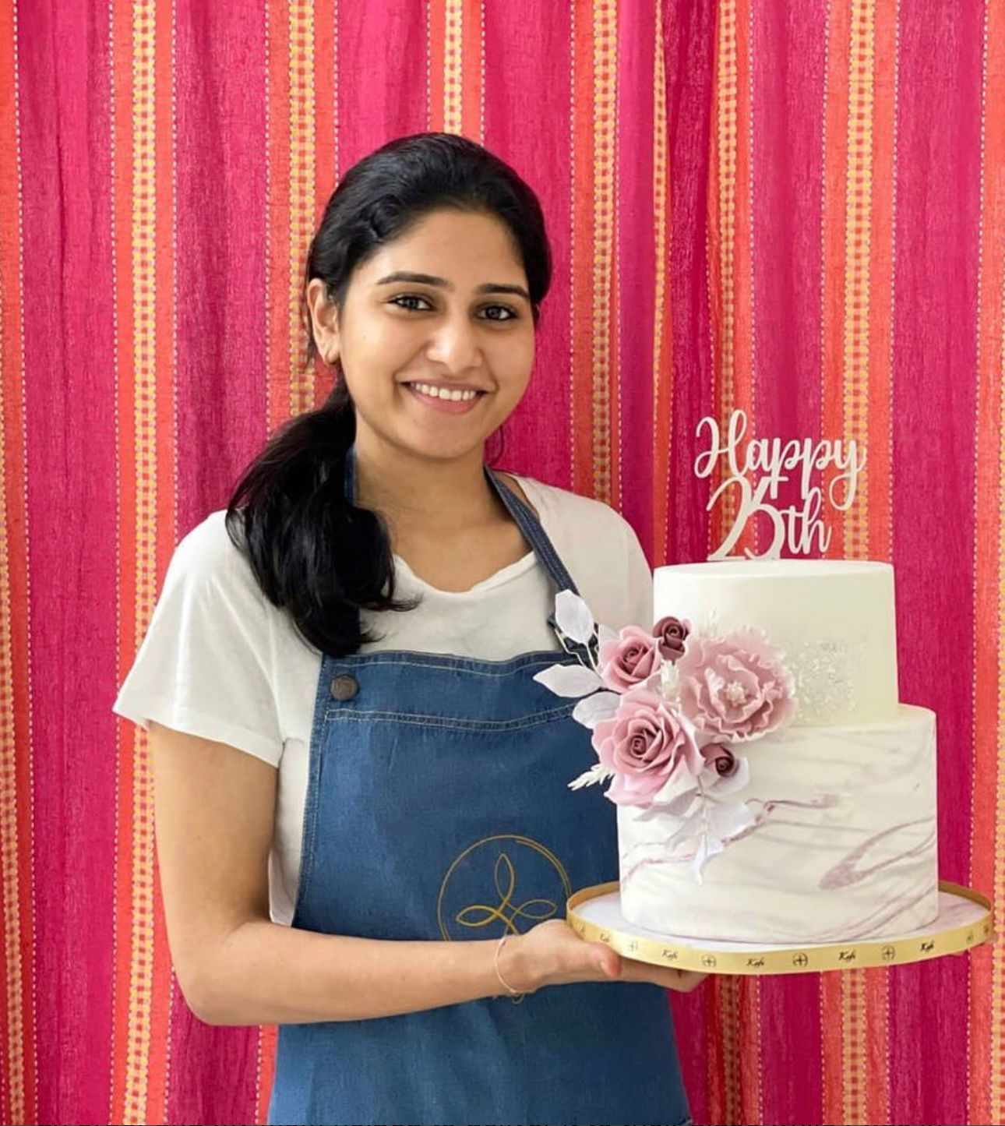
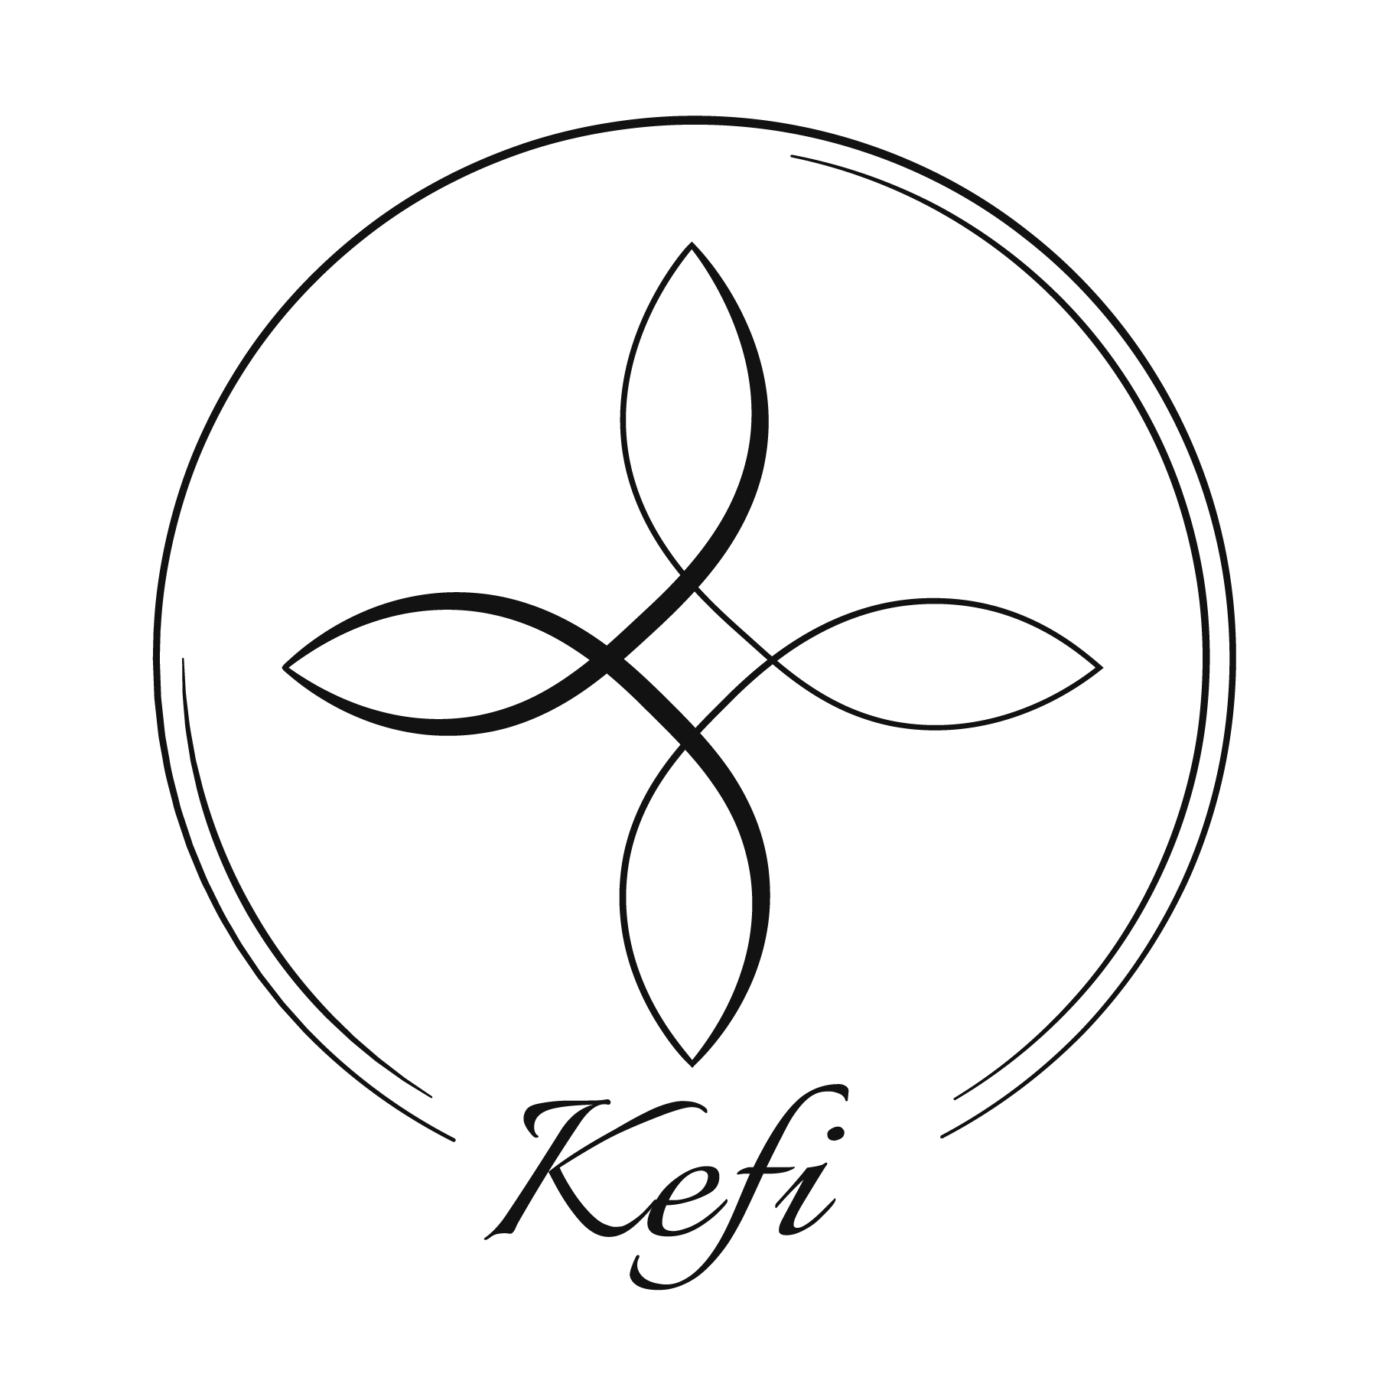
Ad Campaign for Kefi Bakehouse
MGMT 590- Group 7
Mithila Chitukula
Pooja Kannuri
Rahul Kunku
Archita Ray
Akshita Sharma
Srinija Srimamilla

Slide 2

Kefi Bakehouse
Founded in 2020 in Hyderabad, India
It is a homemade custom cake and dessert shop specializing in creating personalized cakes and desserts that cater to the unique requirements of the client for every celebration.

Slide 3


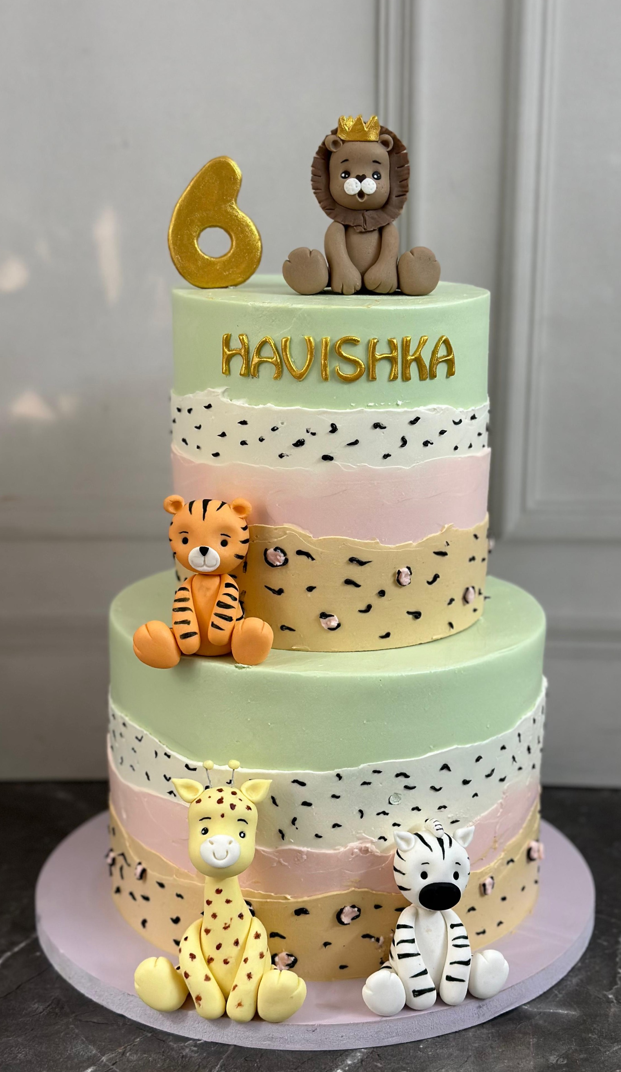

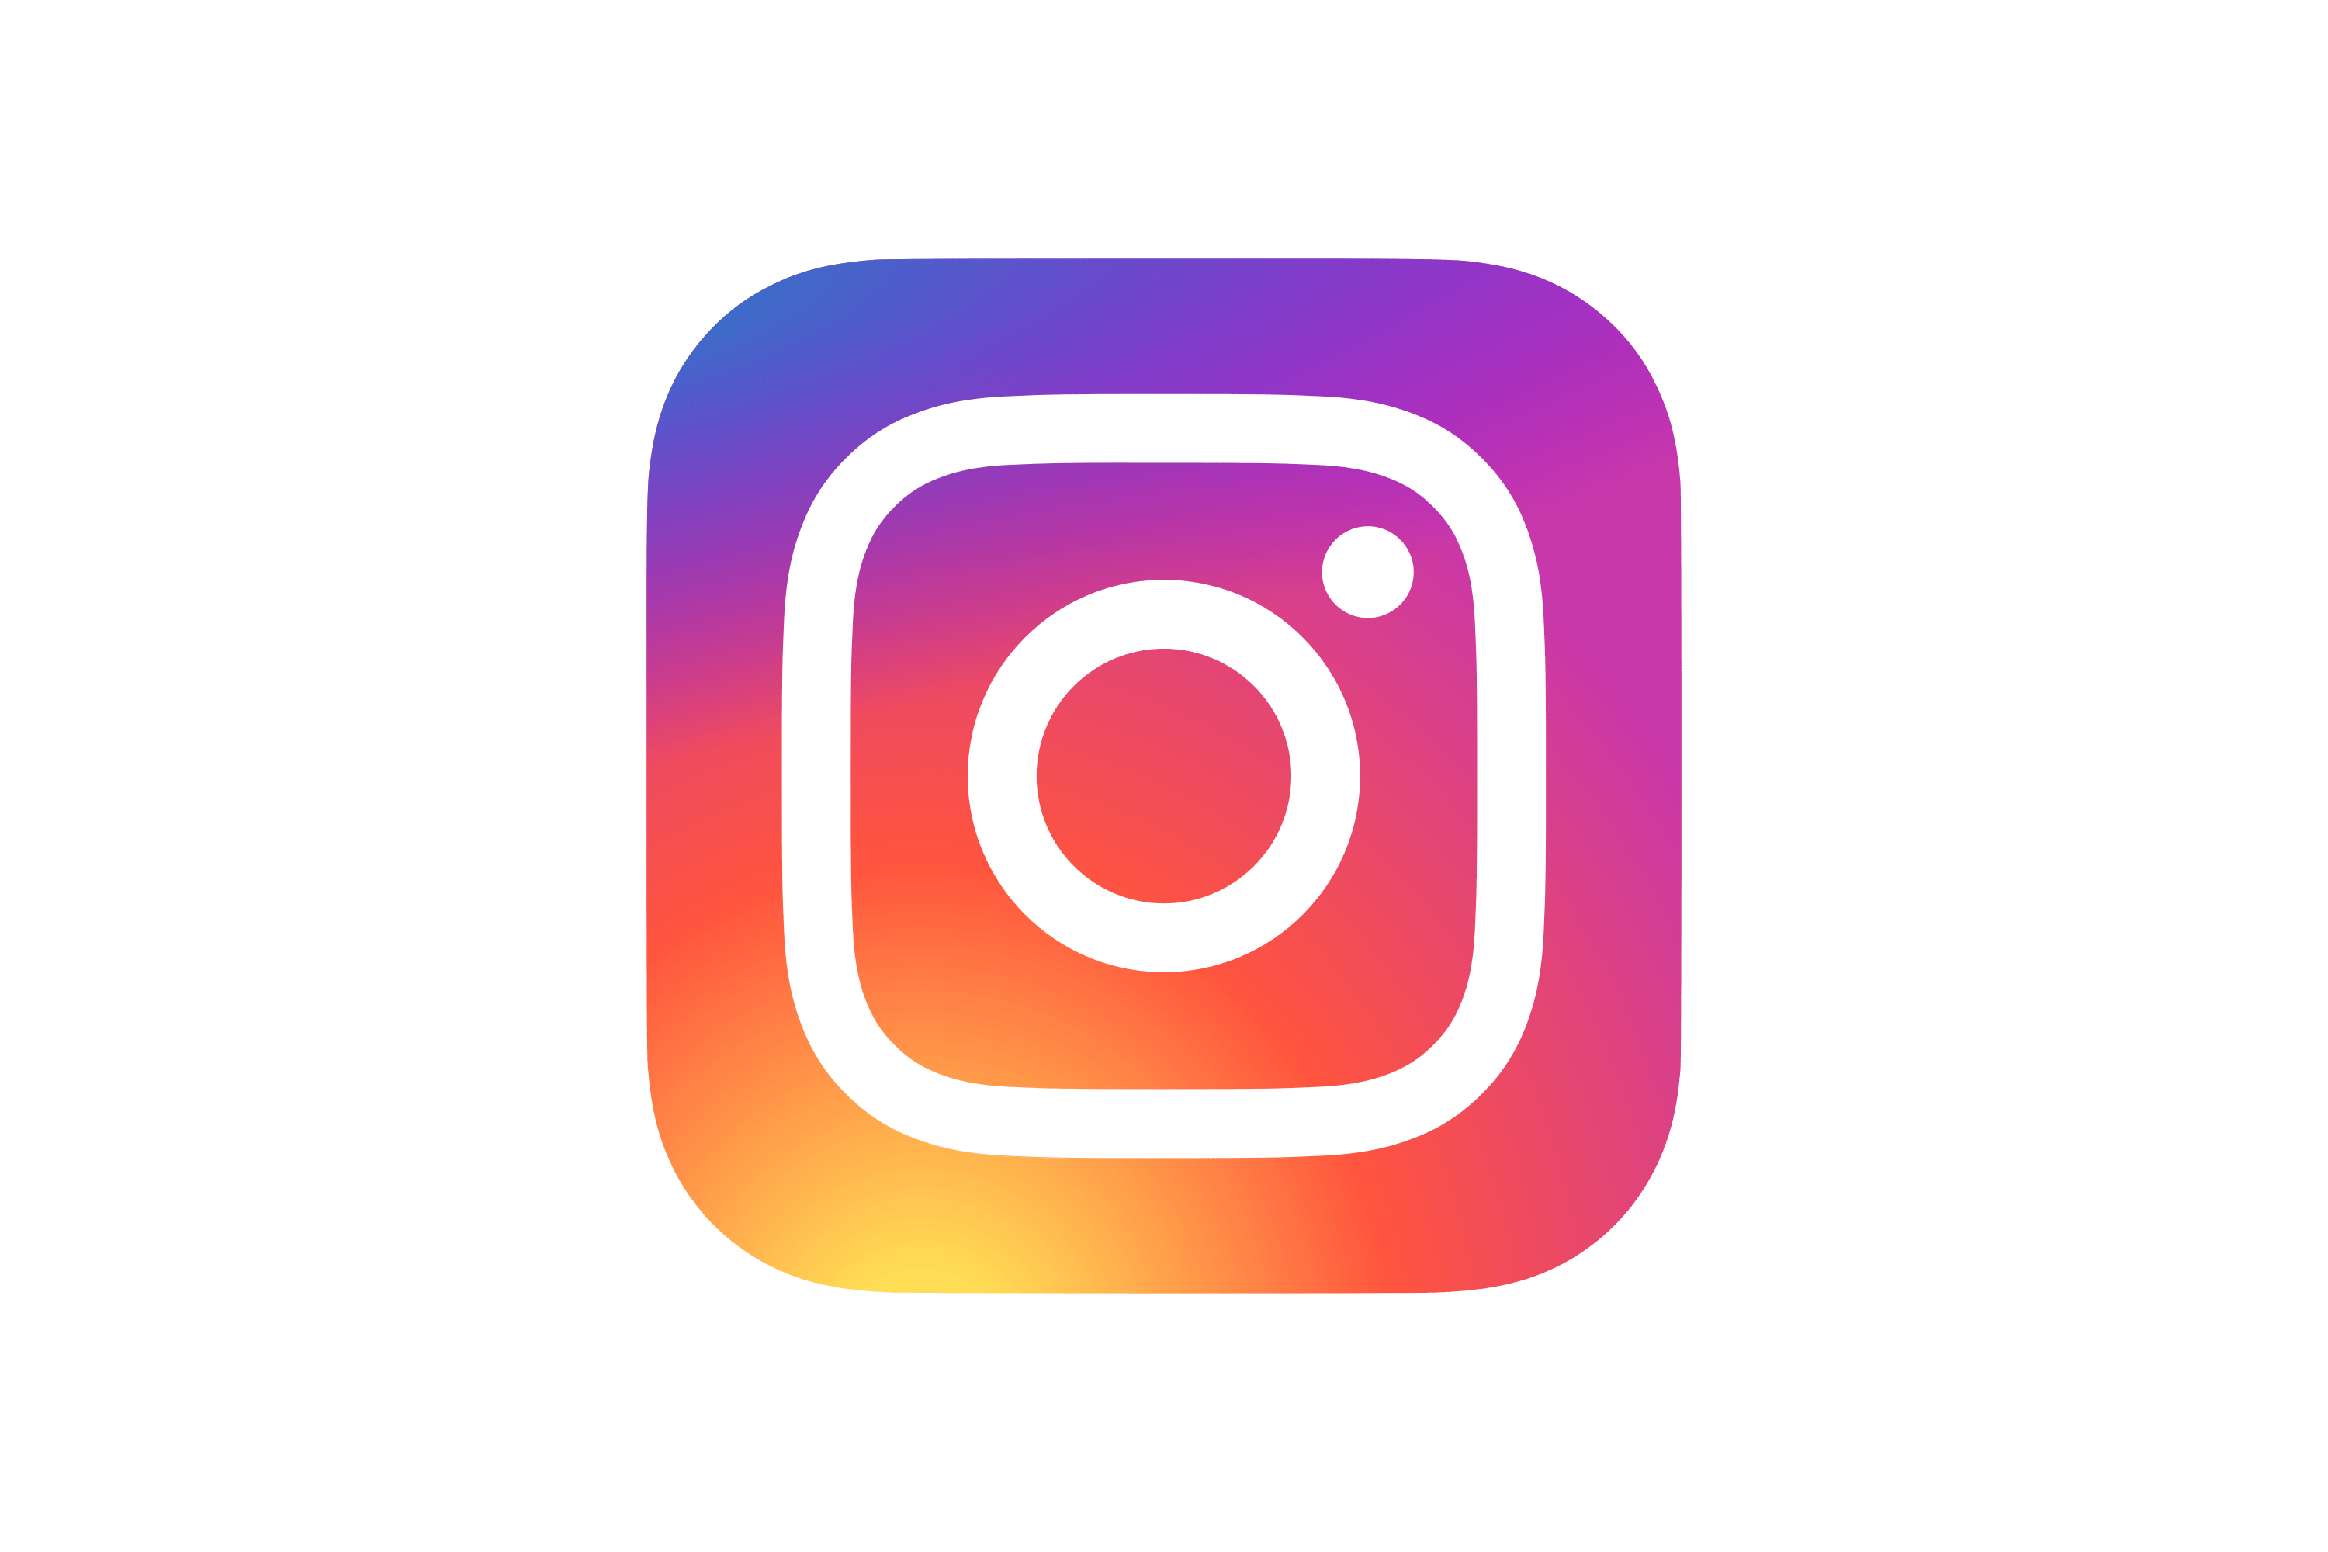
Campaign Overview
Objective
Timeframe
Goal
Platform
To effectively evaluate the performance of two ad variations, using A/B testing
Start Date: April 18, 2024
End Date: April 23, 2024
To find out whether our hypothesis about the muted color theme being preferred by the target audience is indeed valid.
The ads were deployed on Instagram using the platform's Ad Manager
Notes:
For our ad campaign, we used A/B testing where we launched two different ad- one add with vibrant colors and one with muted colors. Our goal was to find whether the muted color theme is indeed preferred by the target audience. We launched the campaign on April 18th and ended it on April 23rd
We used Instagram to launch our ads, as this is the primary platform used by the client

Slide 4
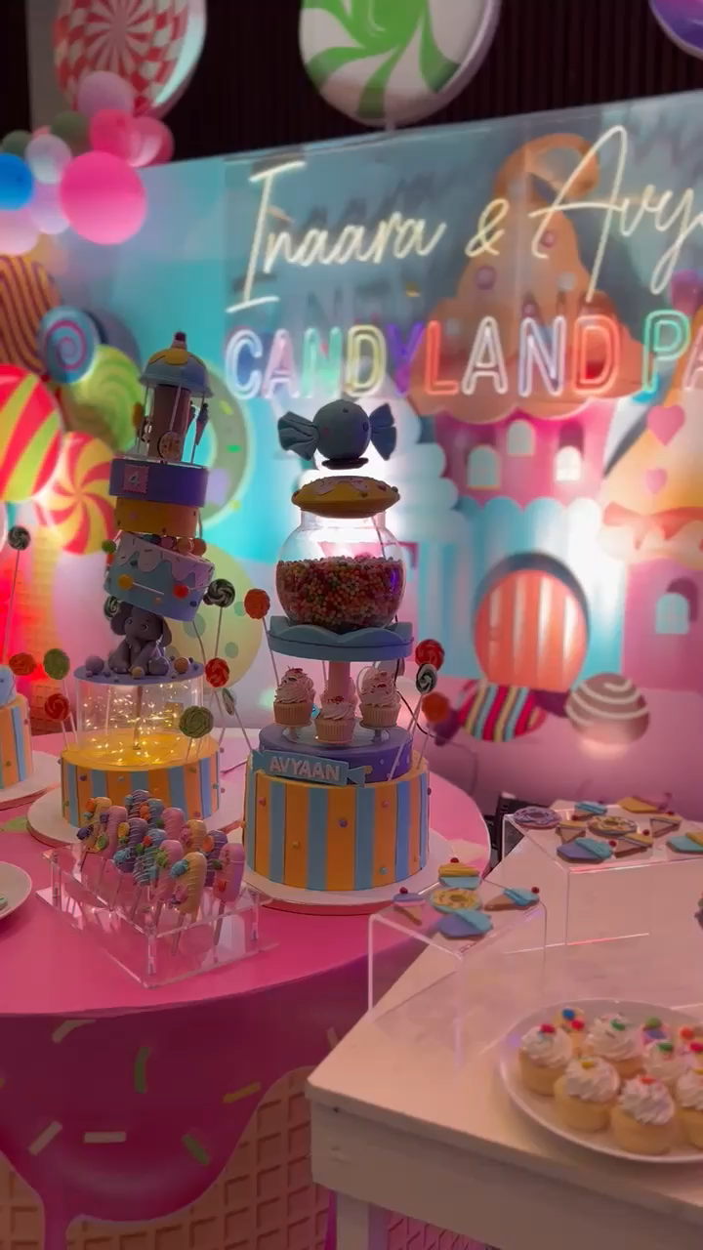
Target Audience
Location
In and around Hyderabad, India
Age
22-45 years
Income
Upper-middle to higher economic class
Luxury and exclusivity, high willingness to pay, celebrate special occasions
Preference
Notes:
Our target audience is based out of Hyderabad, a city in India. The age bracket of the customers is between 22 and 45 years. The customers are usually in the upper-middle to higher economic segment and have a higher willingness to pay. However, when we were unable to enter these categories in Ad Manager so we categorized the criteria as customers who like cakes, brownies and confectionaries

Slide 5
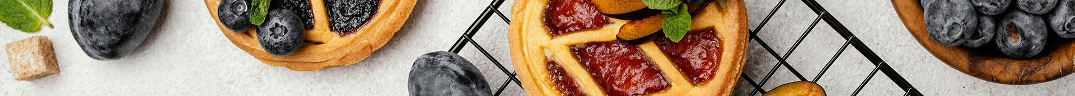


Campaign Strategy
AD A
AD B

Slide 6
Campaign Strategy
AD A
Advertisement elements
Goal: This ad strategically positions Kefi Bakehouse as the epitome of premium quality, emphasizing its extensive selection of intricate cakes tailored to elevate celebratory experiences.
It aims to convey that the bakery stands out as the top choice for those seeking to make their joyous occasions truly grand with its luxurious offerings.
Beige background: Premium stationary feel
Brown Ink: Vintage touch
Complementary Watercolour: Mimics hand-painted
Confetti: Marks celebration

Slide 7
Campaign Strategy
AD B
Advertisement elements
Goal: This ad aims to resonate with a broader audience by showcasing the joy of marking small victories and everyday occasions.
Drawing inspiration from early 2000s aesthetics, vibrant colors like the bright pink used in the ad evoke nostalgia for celebrations, transporting viewers back to the simple joy and excitement of childhood festivities.
Vibrant background: Evokes nostalgia
Spray Paint: Adds fun to daily life
Cheerful Blooms: Life's Delights

Slide 8
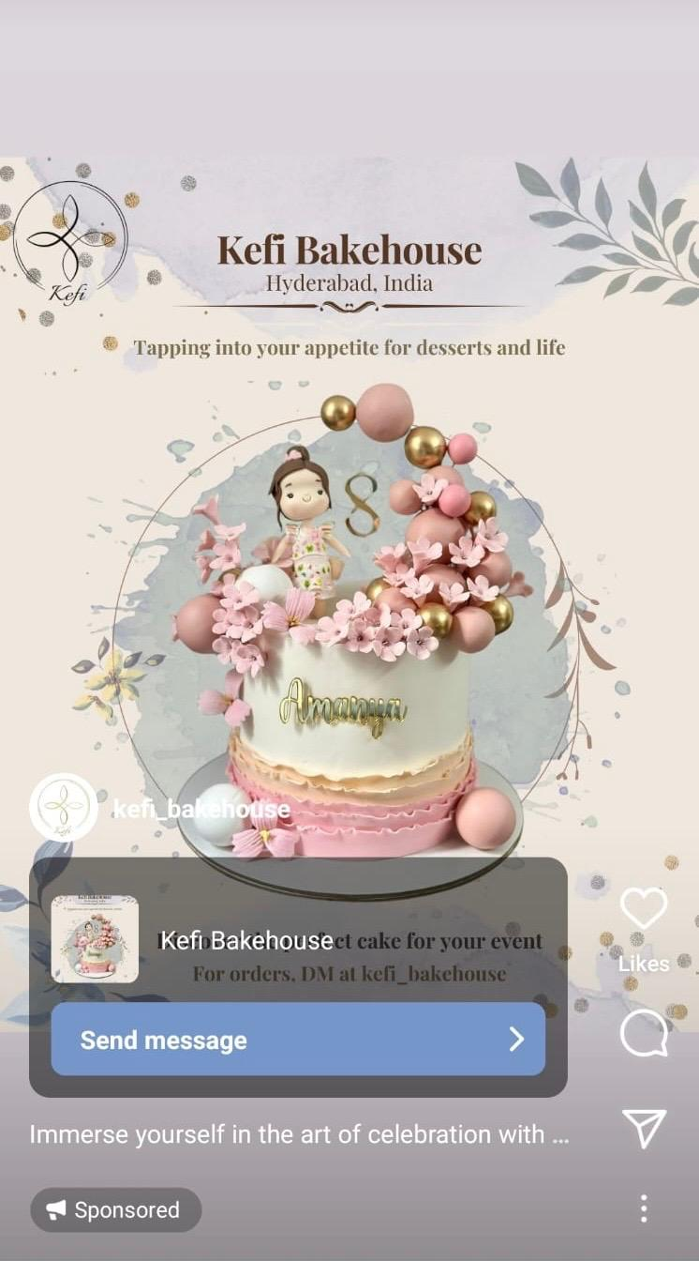





Campaign Timeline
April 14th – 15th
April 18th – 23rd
Monitored the ads
Designed the two ad variations (vibrant and muted color themes)
April 23rd
April 18th
Analyzed the performance of both ads on key metrics
Ad Launch on Instagram
April 16th – 17th
Reviewed ads and received approval from client

Slide 9
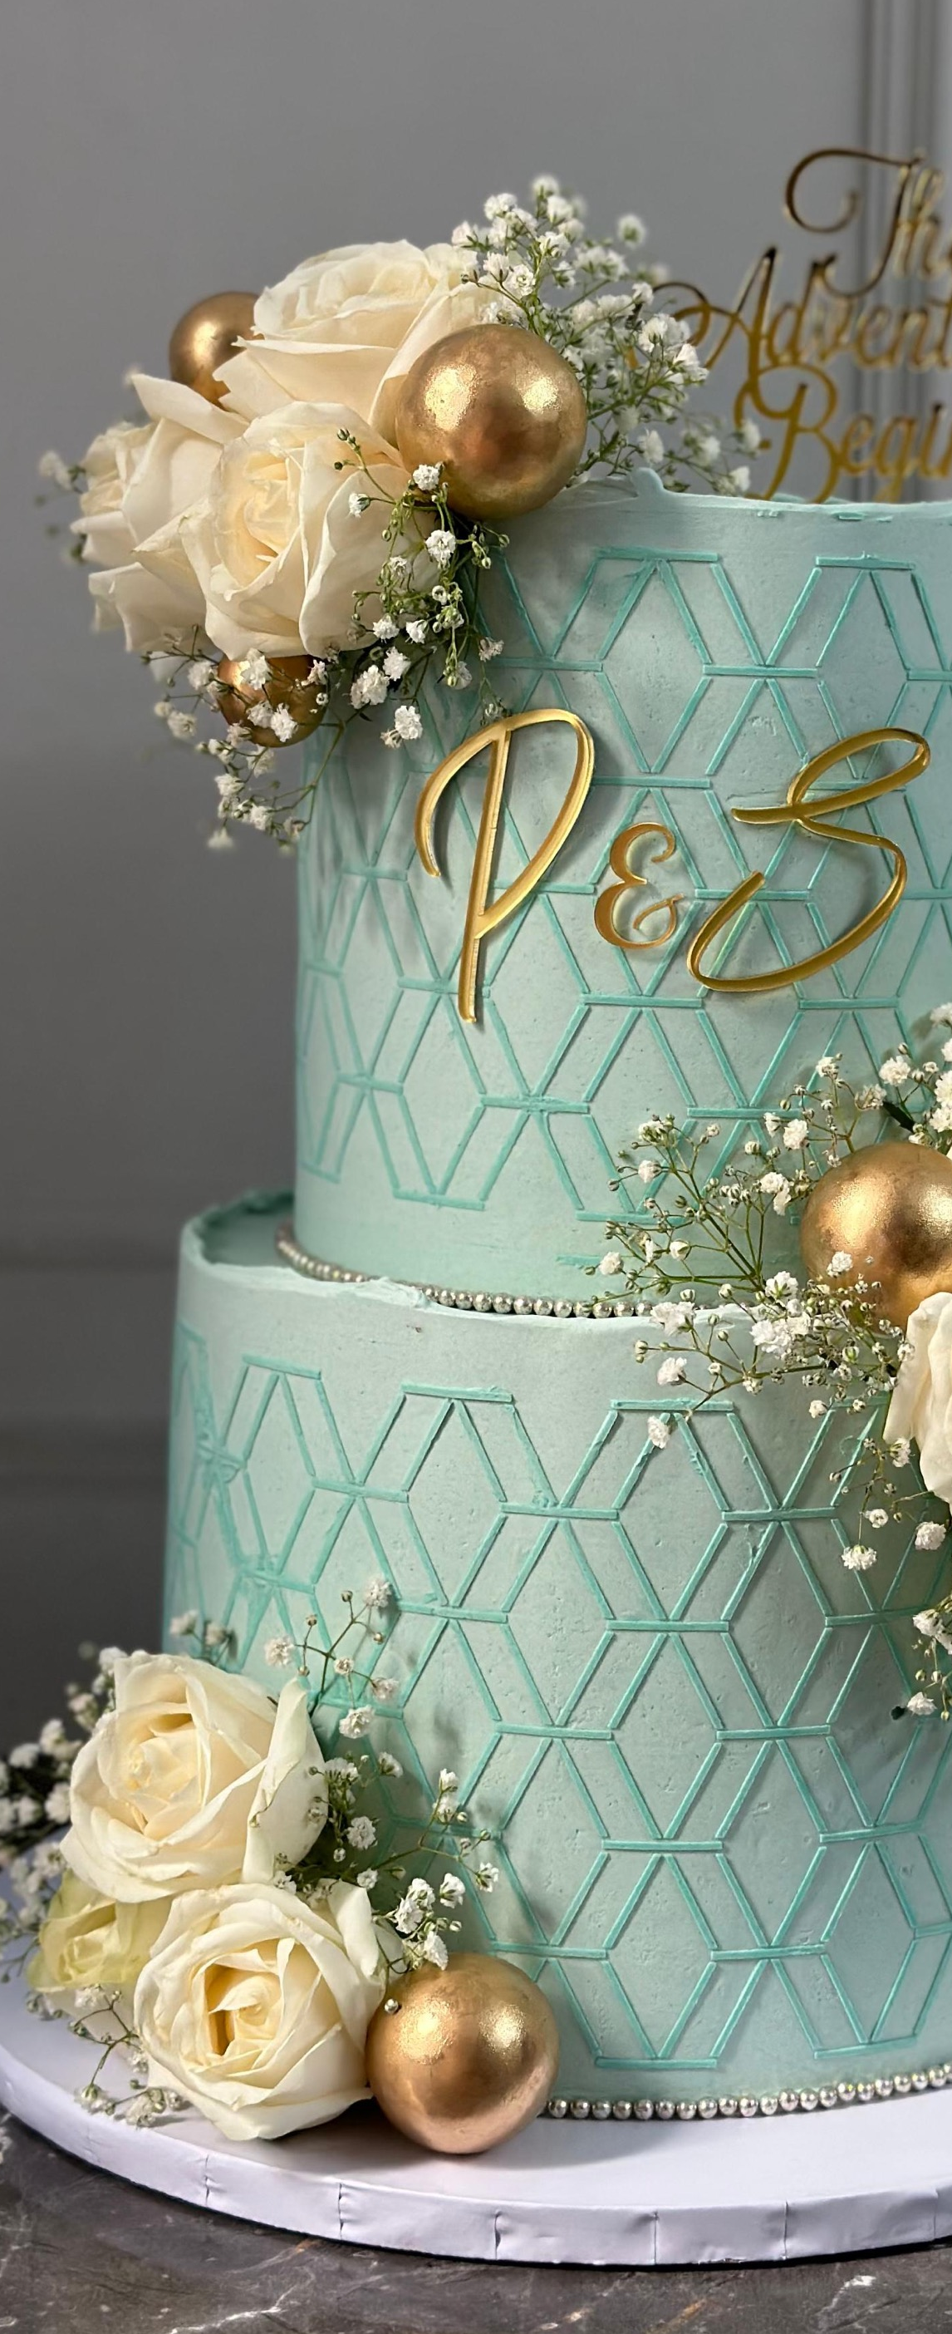
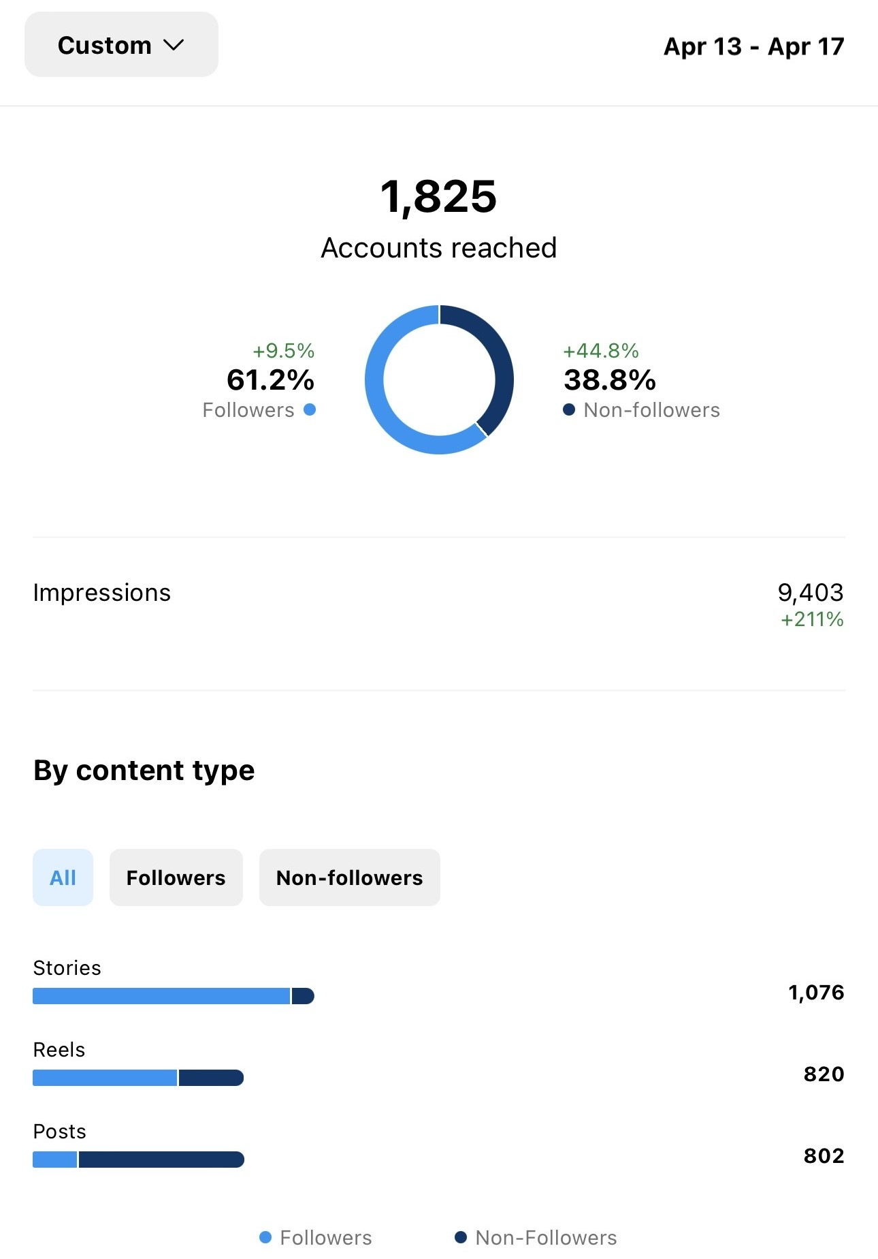
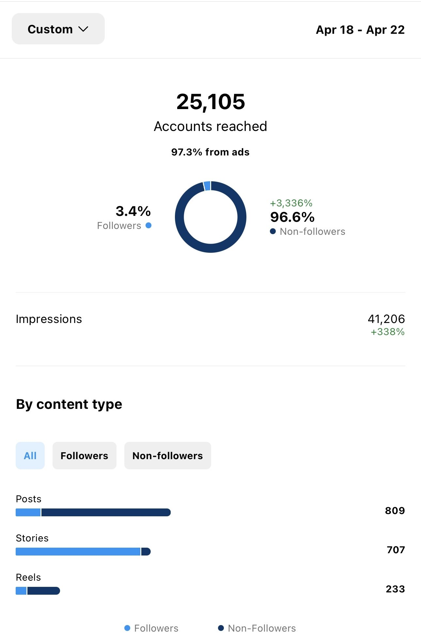
Metrics & Results
Reach before campaign
Reach during campaign

Slide 10
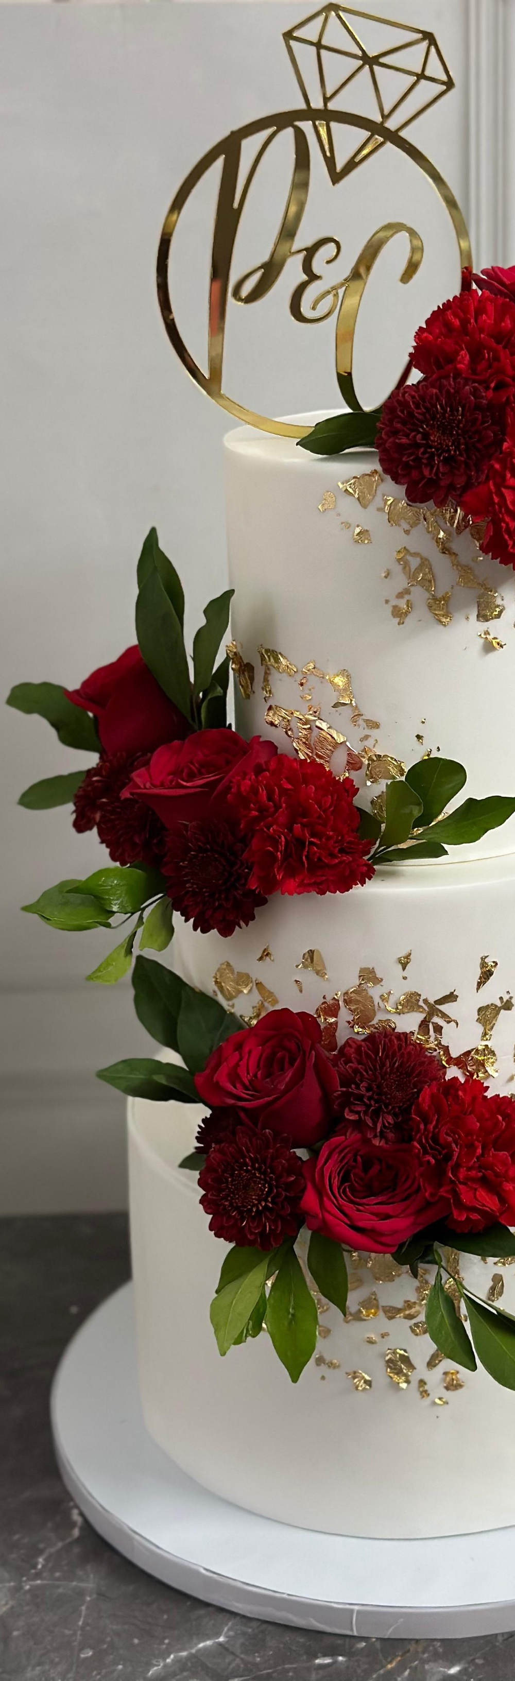
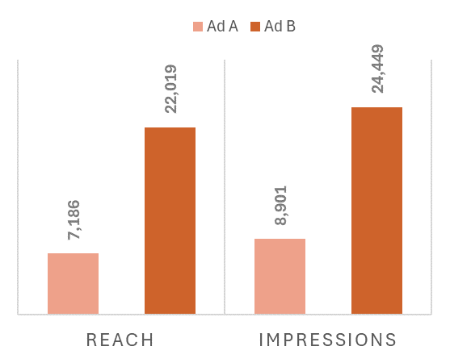
Ad B had higher reach, but Ad A led to more conversations started
Ad A:
Conversations started: 21
Results per impression: 0.24%
Ad B:
Conversations started: 14
Results per impression: 0.06%

Slide 11
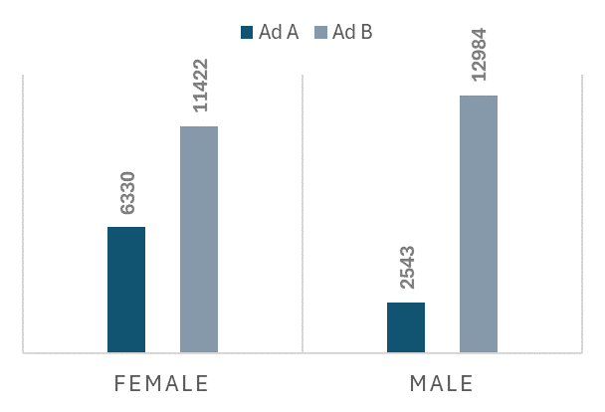
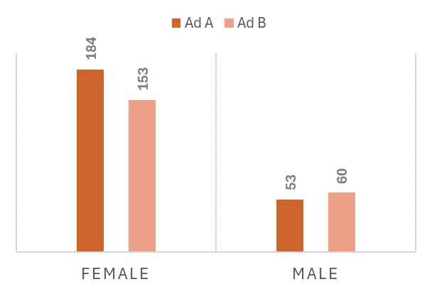
Ad A had the highest CTR across genders
Impressions
Clicks

Slide 12
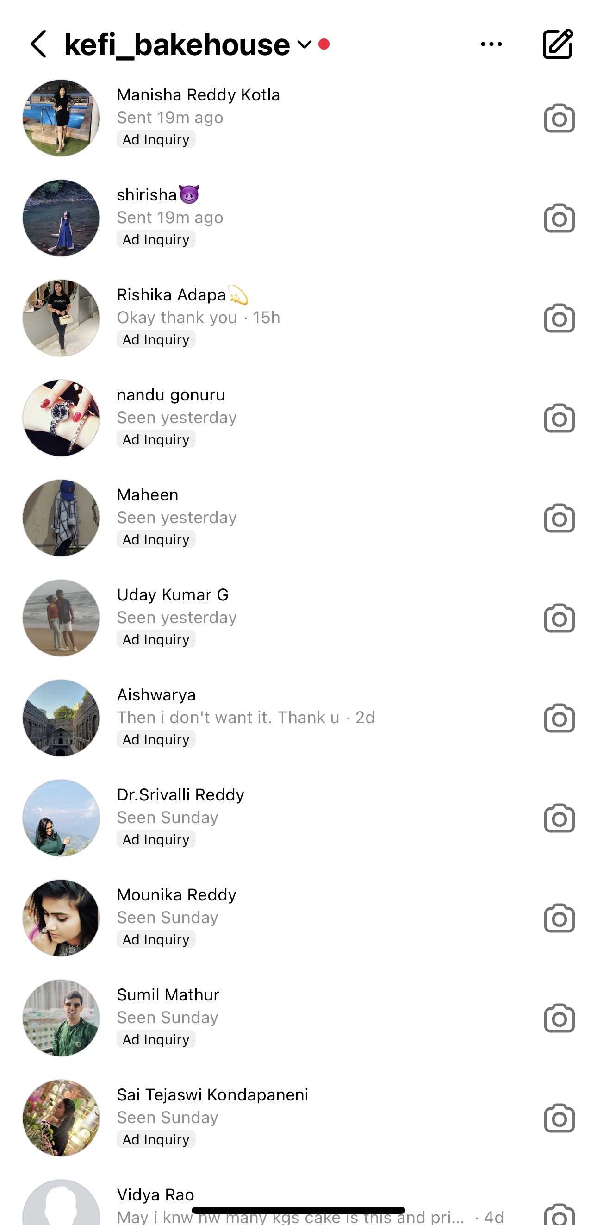
Age 35-44 group had the highest CTR for both ads

Slide 13
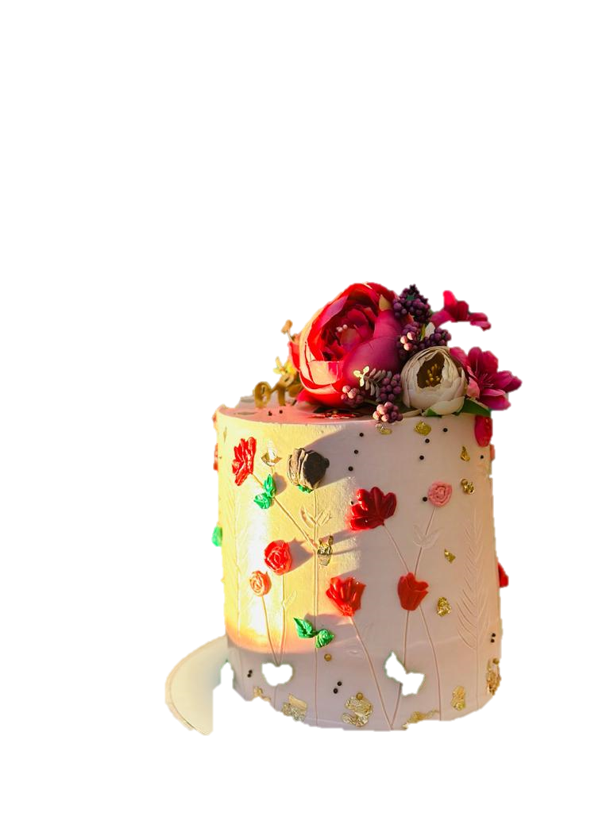
Learnings & Recommendations
Learnings
Greater reach isn’t always reflective of a good ad
Little details matter from a business POV
Recommendations
Targeted ads for different segments
Video ads for more engagement
Replicate successful visual elements
Notes:
Coming to the learnings and recommendations for future work One of the main things we learnt is that a greater reach is not indicative of how good that ad is doing at reaching the target customers. Ad B had 3 times the reach as Ad A but wasn’t able to start conversations
Secondly, your ad should be able to showcase the client’s capabilities. Our client wanted us to show a sophisticated cake that she was proud of.
Recommendations
Utilize Exposure effect: Run ads frequently to ensure people get reminded of you for their celebrations
Targeted Advertising: Kefi has cakes for all age groups and genders. So targeted ads would help build a stronger presence.
That’s all from our side.
Thank you.

Slide 14
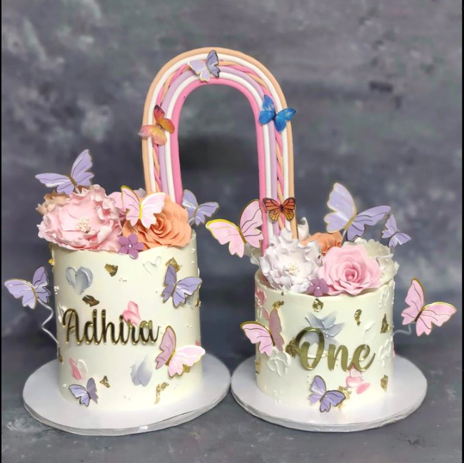
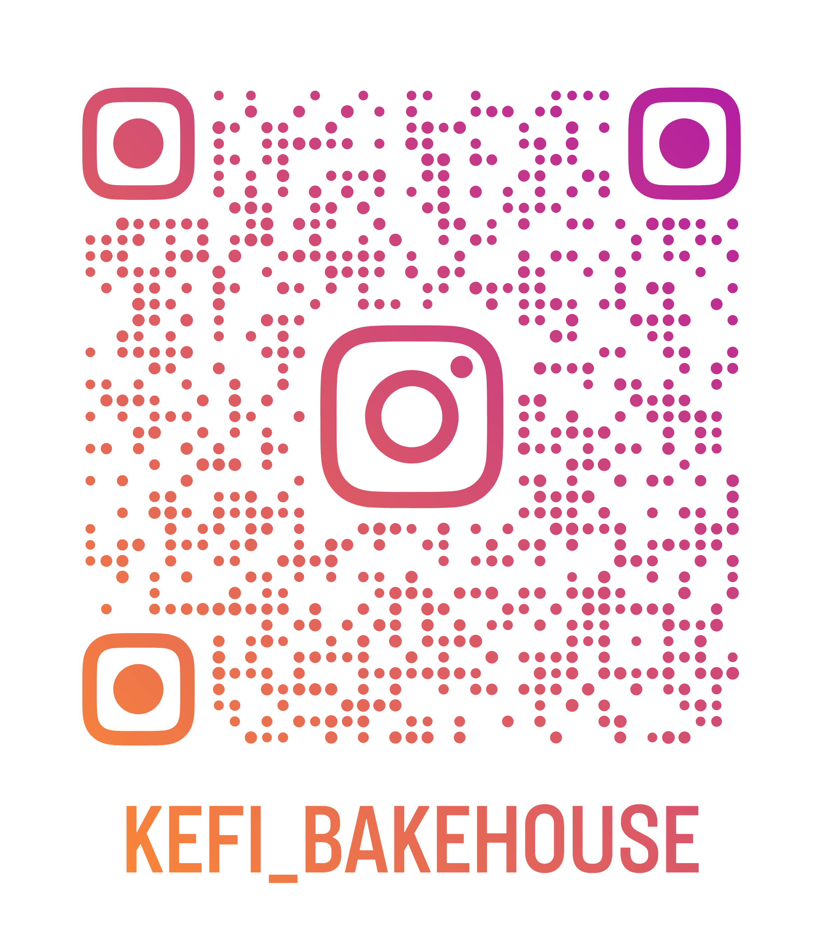
Thank You

